Slide 1
Lab-1
Course code: CSE-407
Course Title: Artificial Intelligence & Neural Networks

Slide 2
What is Bayesian Classification?
Bayesian classifiers are statistical classifiers
For each new sample they provide a probability that the sample belongs to a class (for all classes)
A Naive Bayes Classifier is a supervised machine-learning algorithm that uses the Bayes' theorem, which assumes that features are statistically independent.
Bayesian machine learning allows us to encode our prior beliefs about what those models should look like, independent of what the data tells us.

Slide 3
Bayes’ Theorem: Basics
Let X be a data sample (“evidence”): class label is unknown
Let H be a hypothesis that X belongs to class C
Classification is to determine P(H|X), the probability that the hypothesis holds given the observed data sample X

Slide 4
Bayes’ Theorem: Basics
In other words, we are looking for the probability that tuple X belongs to class C, given that we know the attribute description of X.
P(H|X) is the posterior probability, or a posteriori probability, of H conditioned on X.
For example, suppose our world of data tuples is confined to customers described by the attributes age and income
X is a 35-year-old customer with an income of $40,000.
P(H|X) reflects the probability that customer X will buy a computer given that we know the customer’s age and income

Slide 5
Bayes’ Theorem: Basics
P(H) (prior probability), the initial probability
E.g., X will buy computer, regardless of age, income, …
P(X): probability that sample data is observed
P(X|H) (posteriori probability), the probability of observing the sample X, given that the hypothesis holds
E.g., Given that X will buy computer, the prob. that X is 31..40, medium income

Slide 6
Bayes’ Theorem
Given training data X, posteriori probability of a hypothesis H, P(H|X), follows the Bayes theorem,

Slide 7
Towards Naïve Bayesian Classifiers
Let, D be a training set of tuples and their associated class labels,
Each tuple is represented by an n-D attribute vector
X = (x₁, x₂, …, x_{n})
Suppose there are m classes C₁, C₂, …, C_{m}.
Classification is to derive the maximum posteriori, i.e., the maximal P(C_{i}|X)

Slide 8
Towards Naïve Bayesian Classifiers
This can be derived from Bayes’ theorem
Since P(X) is constant for all classes, only
needs to be maximized

Slide 9
NBC: Training Dataset
Class:
C1:buys_computer = ‘yes’
C2:buys_computer = ‘no’
Data sample
X = (age <=30,
Income = medium,
Student = yes
Credit_rating = Fair)

Slide 10
NBC: Training Dataset
Class:
C1:buys_computer = ‘yes’=9
C2:buys_computer = ‘no’=5

Slide 11
NBC: Training Dataset
P(C_{i}):
P(buys_computer = “yes”)
= 9/14
= 0.643
P(buys_computer = “no”)
= 5/14
= 0.357

Slide 12
NBC: Training Dataset
Data sample
X = (age <=30,
Income = medium,
Student = yes
Credit_rating = Fair)
buys_computer = ‘yes’=9
(age<=30) =2
buys_computer = ‘no’=5
(age<=30) =3

Slide 13
NBC: Training Dataset
Data sample
X = (age <=30, Income = medium, Student = yes ,Credit_rating = Fair)
P(C_{i}): P(buys_computer = “yes”) = 9/14 = 0.643
P(buys_computer = “no”) = 5/14= 0.357
Compute P(X|C_{i}) for each class
P(age = “<=30” | buys_computer = “yes”) = 2/9 = 0.222
P(age = “<= 30” | buys_computer = “no”) = 3/5 = 0.6

Slide 14
NBC: Training Dataset
Data sample
X = (age <=30, Income = medium, Student = yes ,Credit_rating = Fair)
P(C_{i}): P(buys_computer = “yes”) = 9/14 = 0.643
P(buys_computer = “no”) = 5/14= 0.357
Compute P(X|C_{i}) for each class
P(age = “<=30” | buys_computer = “yes”) = 2/9 = 0.222
P(age = “<= 30” | buys_computer = “no”) = 3/5 = 0.6
P(income = “medium” | buys_computer = “yes”) = 4/9 = 0.444
P(income = “medium” | buys_computer = “no”) = 2/5 = 0.4

Slide 15
NBC: Training Dataset
Data sample
X = (age <=30, Income = medium, Student = yes ,Credit_rating = Fair)
P(C_{i}): P(buys_computer = “yes”) = 9/14 = 0.643
P(buys_computer = “no”) = 5/14= 0.357
Compute P(X|C_{i}) for each class
P(age = “<=30” | buys_computer = “yes”) = 2/9 = 0.222
P(age = “<= 30” | buys_computer = “no”) = 3/5 = 0.6
P(income = “medium” | buys_computer = “yes”) = 4/9 = 0.444
P(income = “medium” | buys_computer = “no”) = 2/5 = 0.4
P(student = “yes” | buys_computer = “yes) = 6/9 = 0.667
P(student = “yes” | buys_computer = “no”) = 1/5 = 0.2

Slide 16
Data sample
X = (age <=30, Income = medium, Student = yes ,Credit_rating = Fair)
P(C_{i}): P(buys_computer = “yes”) = 9/14 = 0.643
P(buys_computer = “no”) = 5/14= 0.357
Compute P(X|C_{i}) for each class
P(age = “<=30” | buys_computer = “yes”) = 2/9 = 0.222
P(age = “<= 30” | buys_computer = “no”) = 3/5 = 0.6
P(income = “medium” | buys_computer = “yes”) = 4/9 = 0.444
P(income = “medium” | buys_computer = “no”) = 2/5 = 0.4
P(student = “yes” | buys_computer = “yes) = 6/9 = 0.667
P(student = “yes” | buys_computer = “no”) = 1/5 = 0.2
P(credit_rating = “fair” | buys_computer = “yes”) = 6/9 = 0.667
P(credit_rating = “fair” | buys_computer = “no”) = 2/5 = 0.4

Slide 17
NBC: An Example
X = (age <= 30 , income = medium, student = yes, credit_rating = fair)
P(X|C_{i}) : P(X|buys_computer = “yes”) = 0.222 x 0.444 x 0.667 x 0.667
= 0.044
P(X|buys_computer = “no”) = 0.6 x 0.4 x 0.2 x 0.4
= 0.019

Slide 18
NBC: An Example
X = (age <= 30 , income = medium, student = yes, credit_rating = fair)
P(X|C_{i}) : P(X|buys_computer = “yes”) = 0.222 x 0.444 x 0.667 x 0.667
= 0.044
P(X|buys_computer = “no”) = 0.6 x 0.4 x 0.2 x 0.4
= 0.019
P(X|C_{i})*P(C_{i}) :
P(X|buys_computer = “yes”) * P(buys_computer = “yes”) = 0.028
P(X|buys_computer = “no”) * P(buys_computer = “no”) = 0.007
Therefore, X belongs to class (“buys_computer = yes”)

Slide 19
Naive Bayesian Classifier Example
play tennis?

Slide 20
Naive Bayesian Classifier Example
9
5

Slide 21
Naive Bayesian Classifier Example
Given the training set, we compute the probabilities:
We also have the probabilities
P = 9/14
N = 5/14

Slide 22
Naive Bayesian Classifier Example
To classify a new sample X:
outlook = sunny
temperature = cool
humidity = high
windy = false
Therefore X takes class label N

Slide 23
Naive Bayesian Classifier Example
Second example X = <rain, hot, high, false>
outlook = rain
temperature = hot
humidity = high
windy = false
Sample X is classified in class N (don’t play)

Slide 24
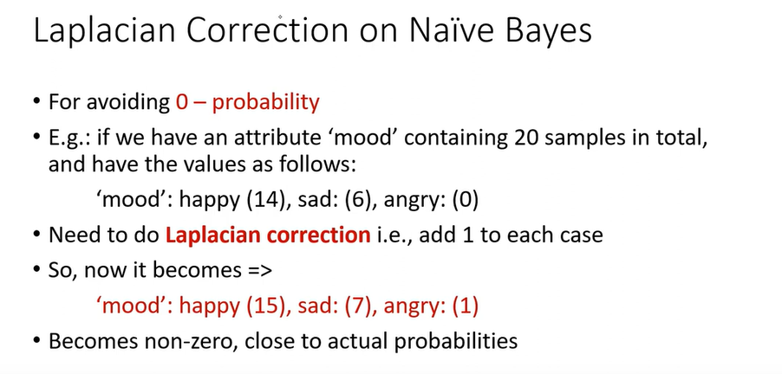
Naive Bayesian Classifier

Slide 25
Naive Bayesian Classifier
Advantages
Easy to implement
Good results obtained in most of the cases

Slide 26
Naive Bayesian Classifier
Disadvantages
Assumption: class conditional independence, therefore loss of accuracy
Practically, dependencies exist among variables
E.g., hospitals: patients: Profile: age, family history, etc.
Symptoms: fever, cough etc., Disease: lung cancer, diabetes, etc.
Dependencies among these cannot be modeled by Naïve Bayesian Classifier

Slide 27
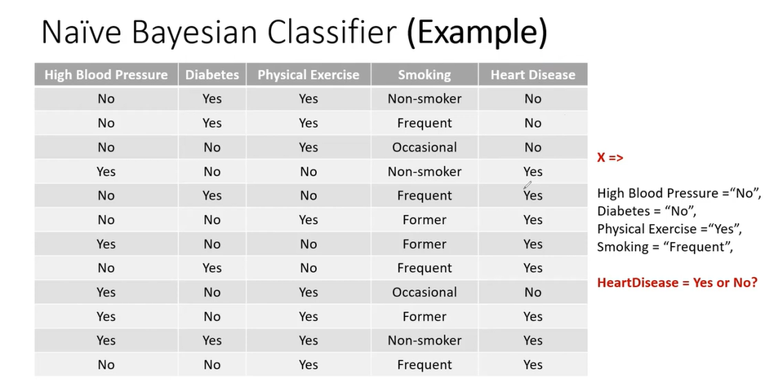
Assignment:

Slide 28
Thank You
Any Question
?

